Slide 1
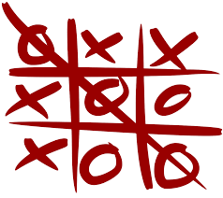
PROJECT : BUILDING THE FAMOUS TIC TAC TOE GAME IN PYTHON
TIC TAC TOE GAME

